Slide 1
Greg Focaccio - Employee Brief
Greg Focaccio
Code #
IT Specialist
Month Day, 2025
1

Slide 2


Greg Focaccio – Employee Brief, BLUF
Family Life
Work Life
Granting Network Wishes
at NIWC PAC
Vacation in Alaska 2025
2

Slide 3
Greg Focaccio – Employee Brief, BLUF
Personal
Native San Diegan, Married for 16 years
Three children (12, 9, 4) at home, three grown step-children with 4 grandkids
Enjoy learning about and experimenting with new network technologies (garage lab)
Enjoy camping with family, hiking in the local desert and mountains, bodysurfing, and tennis
Professional
Previous Work
15 years of hands-on Network Engineering experience
Worked as Lead Engineer at multiple Internet Service Providers and network consulting companies
NIWC PAC
Joined 4 years ago (2021), working on X Project in Code X as contractor
Became Civilian Navy 2 years ago (2023)
Hope to remain here for the duration of my career
Made key technical contributions to the X project
Plan to continue work as technical contributor
Open for opportunities to begin managing technical teams
3

Slide 4
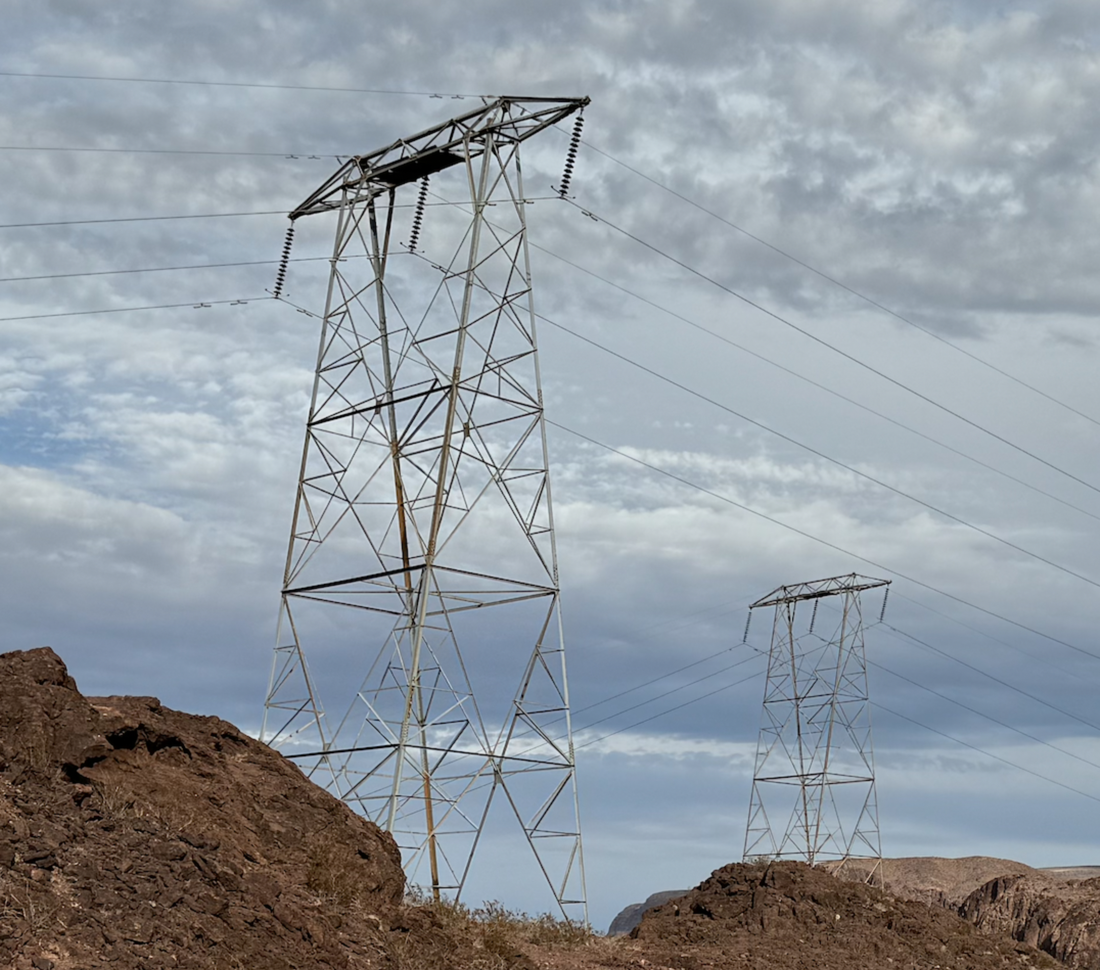
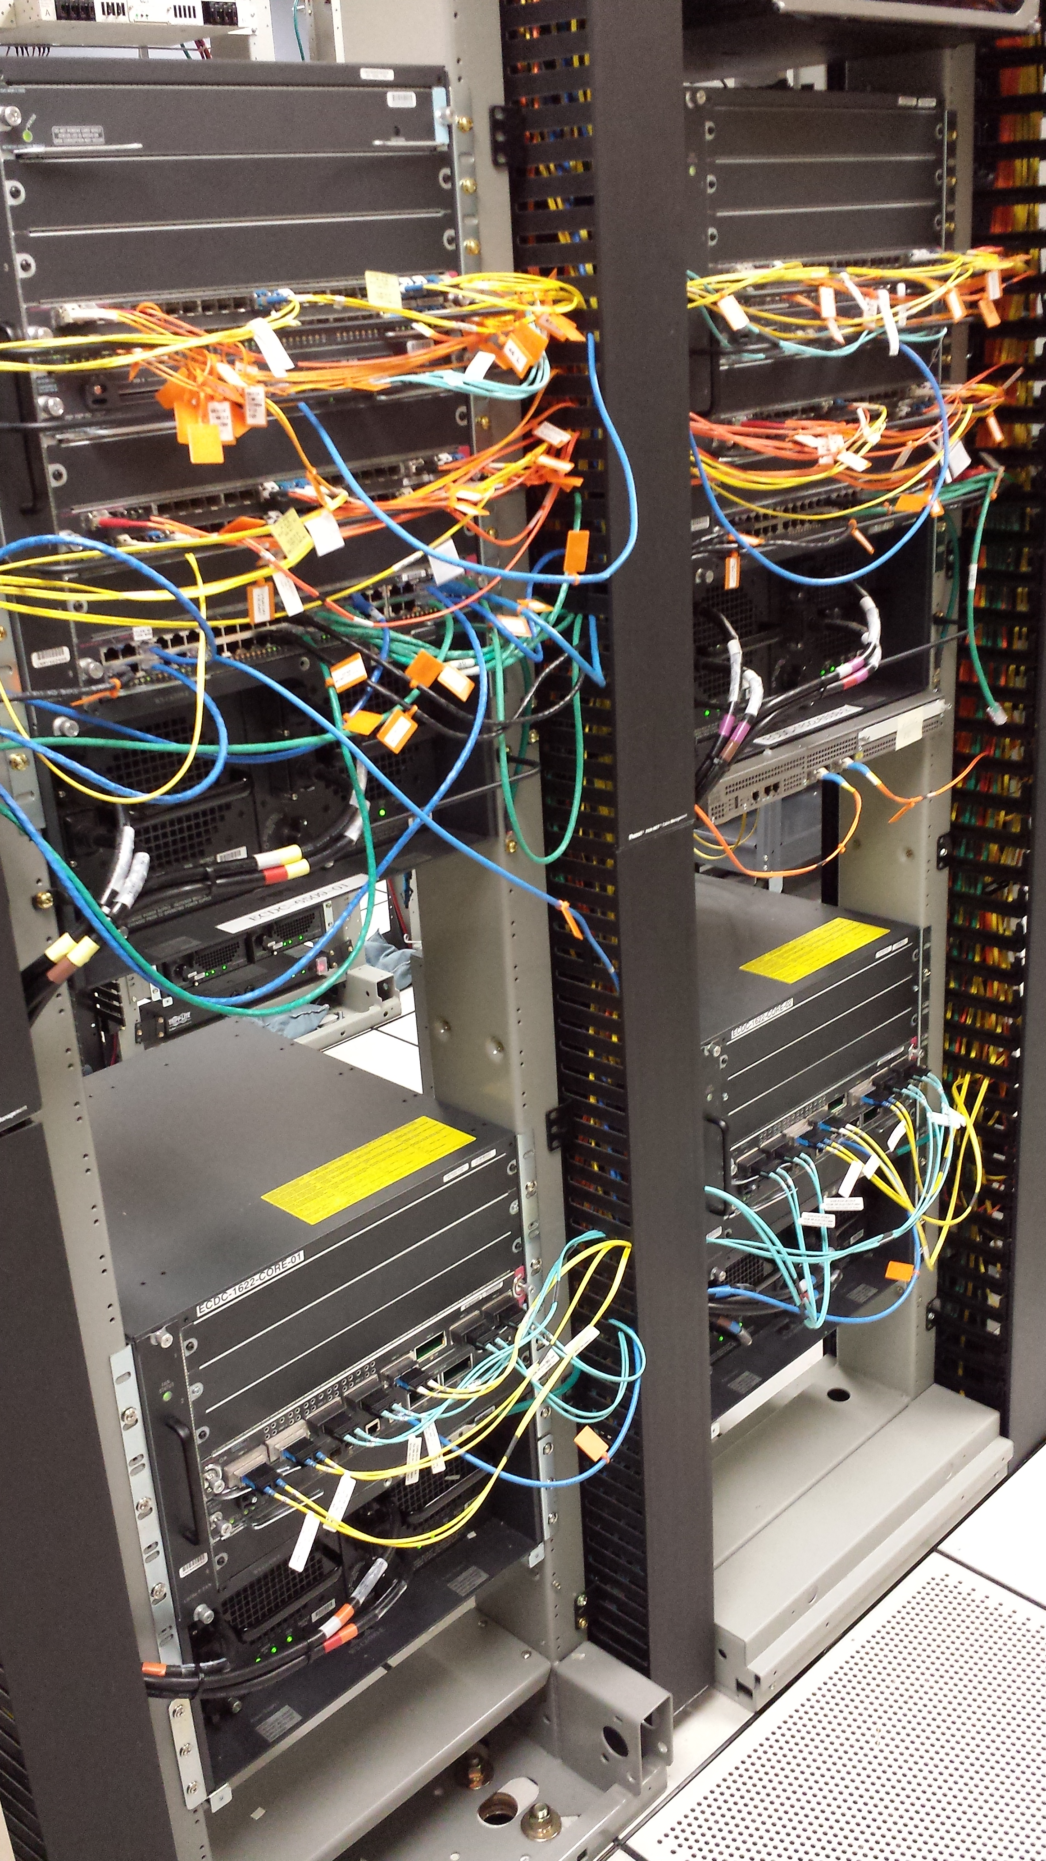
Greg Focaccio – Network Technology Layer
Where I work
Military
Systems for
Strategic and Tactical
Power
Electrical
Power
Networked Information
Power
4

Slide 5
Greg Focaccio – Network Technology Layer Growth
AI and Proliferation of Systems
Requires even more Networked Information Power
Systems for
AI
Power
Proliferating Systems
or Strategic and Tactical
Military Power
Electrical
Power
Networked Information
Power
5

Slide 6
Greg Focaccio – Background, Pre-NIWC
Education
Pomona College, BA Biology, Cum Laude 1991
Medical School (Incomplete) 1992-1995
Adult School / Cisco Network Academy Southwestern College
Work Experience
15+ Years across the full spectrum of types of Network Work
Design and Engineering
Implementation and Infrastructure
Operations and Troubleshooting
Prior to NIWC PAC
1 Year – Principal Network Engineer – SD Datacenter ISP (M5 Hosting) 2021
2 Years – (DoD) SIPR Transport NMCI (Perspecta) 2018-2020
2 Years – Principal Network Engineer – SD Datacenter ISP (CARI.net)
3 Years – Senior Network Engineer – Network ISP and VoIP Provider (NextLevel Internet)
3 Years – Partner Network Engineer – Network Consulting Company (GoNet Forward)
4 Years – Junior Network Engineer – Network Services Company (Network Insight)
Certifications
CCNP Cisco Certified Network Professional (Past)
Security+ (Current)
6

Slide 7
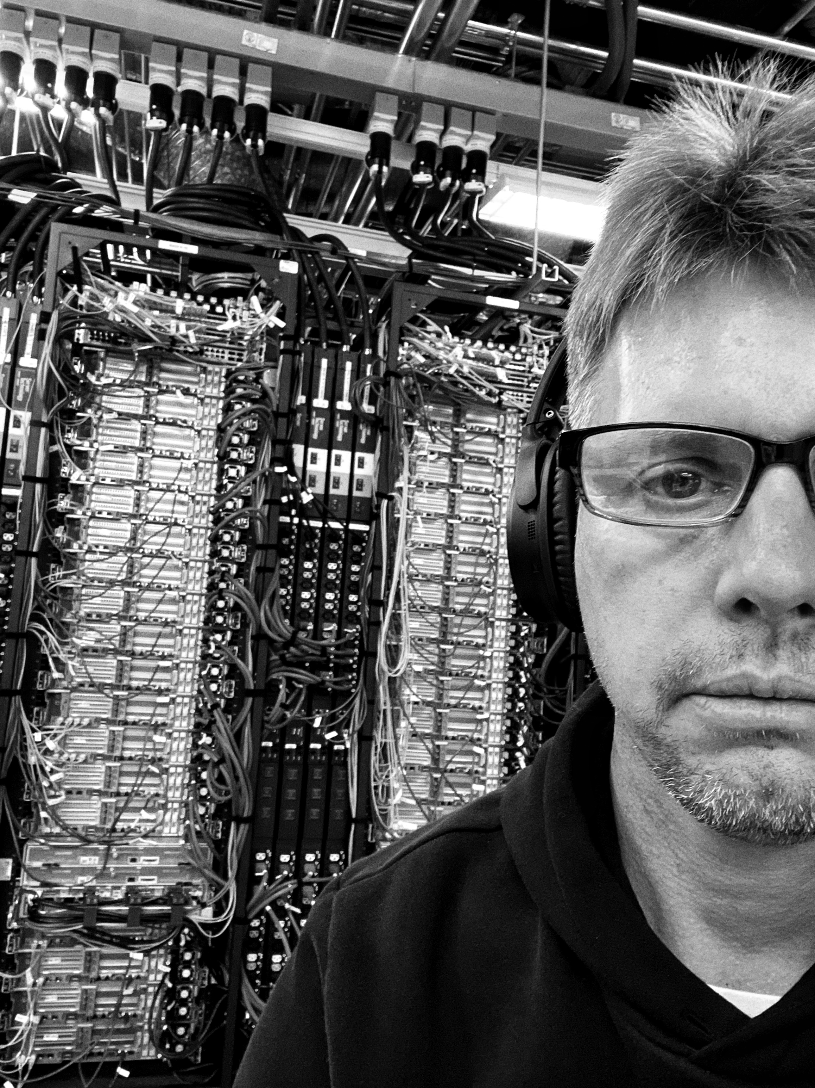
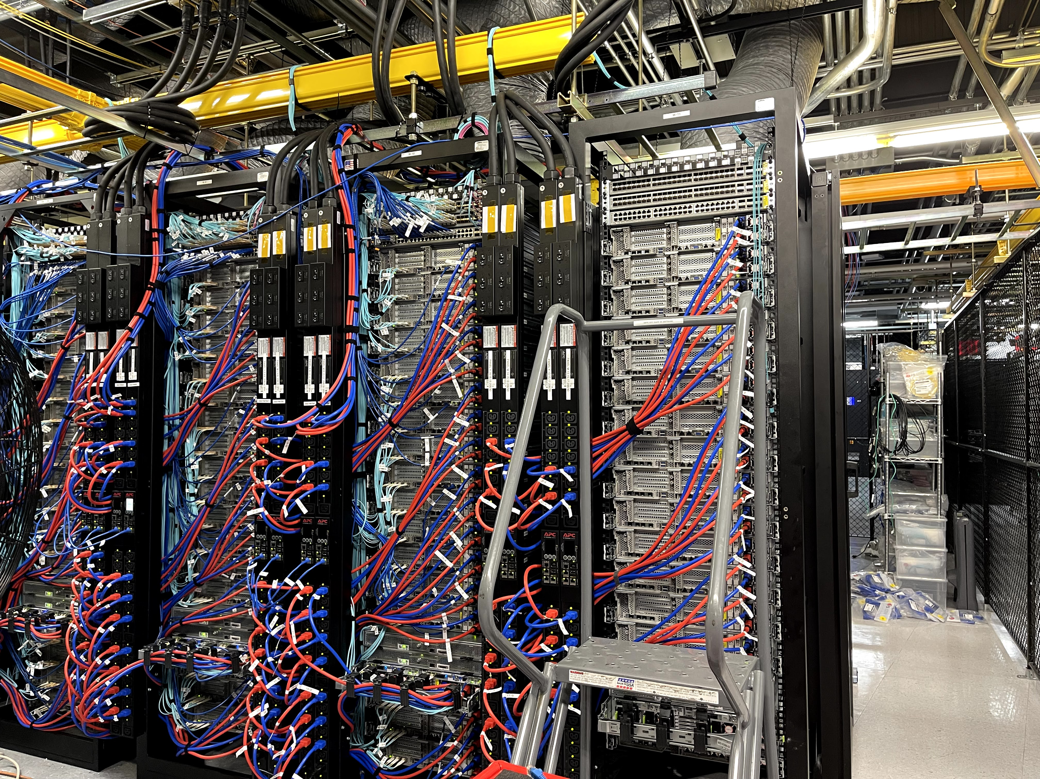
Greg Focaccio – Work, Pre-NIWC
Building networks
for M5 and Meraki
Early 2020, Sorrento Valley
7

Slide 8
Greg Focaccio - NIWC PAC - Career, Current
4th Year at NIWC PAC – Since Summer 2021
Network Engineer with same Branch / Project
NAME and Purpose of Code/Branch
2nd Year as Navy Civilian – Since Spring 2023
IT Specialist (Network Lead)
Develop and Refine Network Roadmap
Support wider view and longer-term objectives coming from NAVWAR and Program Office
Provide novel capabilities and ideas to NAVWAR and PO via Team IPT and LE
Network RDTE - Create Engineered and Tested Solutions, Capabilities, and Integrations
Network Implementations - Support Fleet and Lab Build-Outs, Modernizations, and Integrations
Network Operations– Back-stop for Fleet Operations, Incident Management (CASREPs), and Troubleshooting
8

Slide 9
Greg Focaccio - NIWC PAC – Project Accomplishments
Fleet
Engineered key cybersecurity improvement, satisfying major FCC Program requirement
Delivered key cybersecurity requirement to Fleet enabling Major Milestone (cutover) for Project
System accepted on DATE as modernized replacement for past system within X
Supported initial site implementation of Cybersecurity improvements
Delivered First Network Visibility Capability to System
Supported key external System Assessments
Provided key network engineering required to enable high profile international cooperative functional demonstration of new undersea communication modality
SCITF (Pac X Lab)
Modernized Management of Lab Network
Added New Lab Capabilities
New wide area network (WAN) simulator
Tools and network modeling software
Enabled International Network Link to UK for key capability functional demonstration
9

Slide 10
Greg Focaccio - NIWC PAC – Project Goals
FY 26-28
Fleet
New Network Architecture, Hardware Modernization, New Services
IP addressing, WAN architecture, New virtualized environments
Mature monitoring and management services
Mature Cybersecurity hardening
Identity and Access Management, Zero Trust Architectures
Introduction of Automation
Infrastructure as code
Maintain and grow key integrations and new capabilities
Lab
Maintain and improve lab conformance as Fleet representative engineering and test environment
Develop new approaches to configuration automation and testing automation
Support more system of systems lab integrations to enable more complete E2E testing
10

Slide 11
Greg Focaccio - NIWC PAC - Career, Future
Next 2-3 Years
Continue as technical contributor on project during key modernizations
Learn about and promote openness to working as technical contributor on other high profile network heavy projects
Begin to develop Team leadership experience and training
Open to Initial roles as Technical team lead (IPT)
4 Years out and beyond from present:
Gain experience as Technical team lead
Further out
Mentor as Technical Lead to Junior Technical leads
11

Slide 12
Greg Focaccio - Personal Info, Family
Family History
Father’s side: Italian (Naples), Immigrated to US via Ellis Island in 1880
Mom’s side: French Canadian, in US since 1800s, Settled in Somerset, Wisconsin (small farm town)
Me: Native San Diegan
Father came to San Diego visiting his sister, a Navy Nurse, then decided to move here (‘65)
Mom followed a school friend from Somerset to San Diego (‘66)
My Family
Home in Tierrasanta (Near Miramar Air Station)
Married to Karen for 16 years
3 Children: 12 Raffaela, 9 Dalton, 4 Isabella
3 Older Step-Children (out of the house): (Twins) 27, 27, and 29
One daughter, Married to Army Sergeant - Returning to Fort Irwin, CA next year
One daughter, Senior Airman, Airforce as GIS, at Beal AFB, CA
Pets
Desert Tortoise
Small Dog – Toy Poodle mix
12

Slide 13
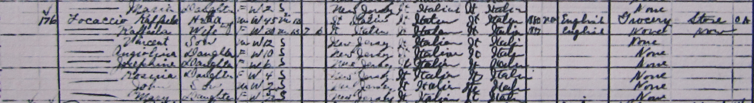

Greg Focaccio - Personal Info, Family
Great Grandfather in US Census 1910 – Jersey City, New Jersey
13

Slide 14
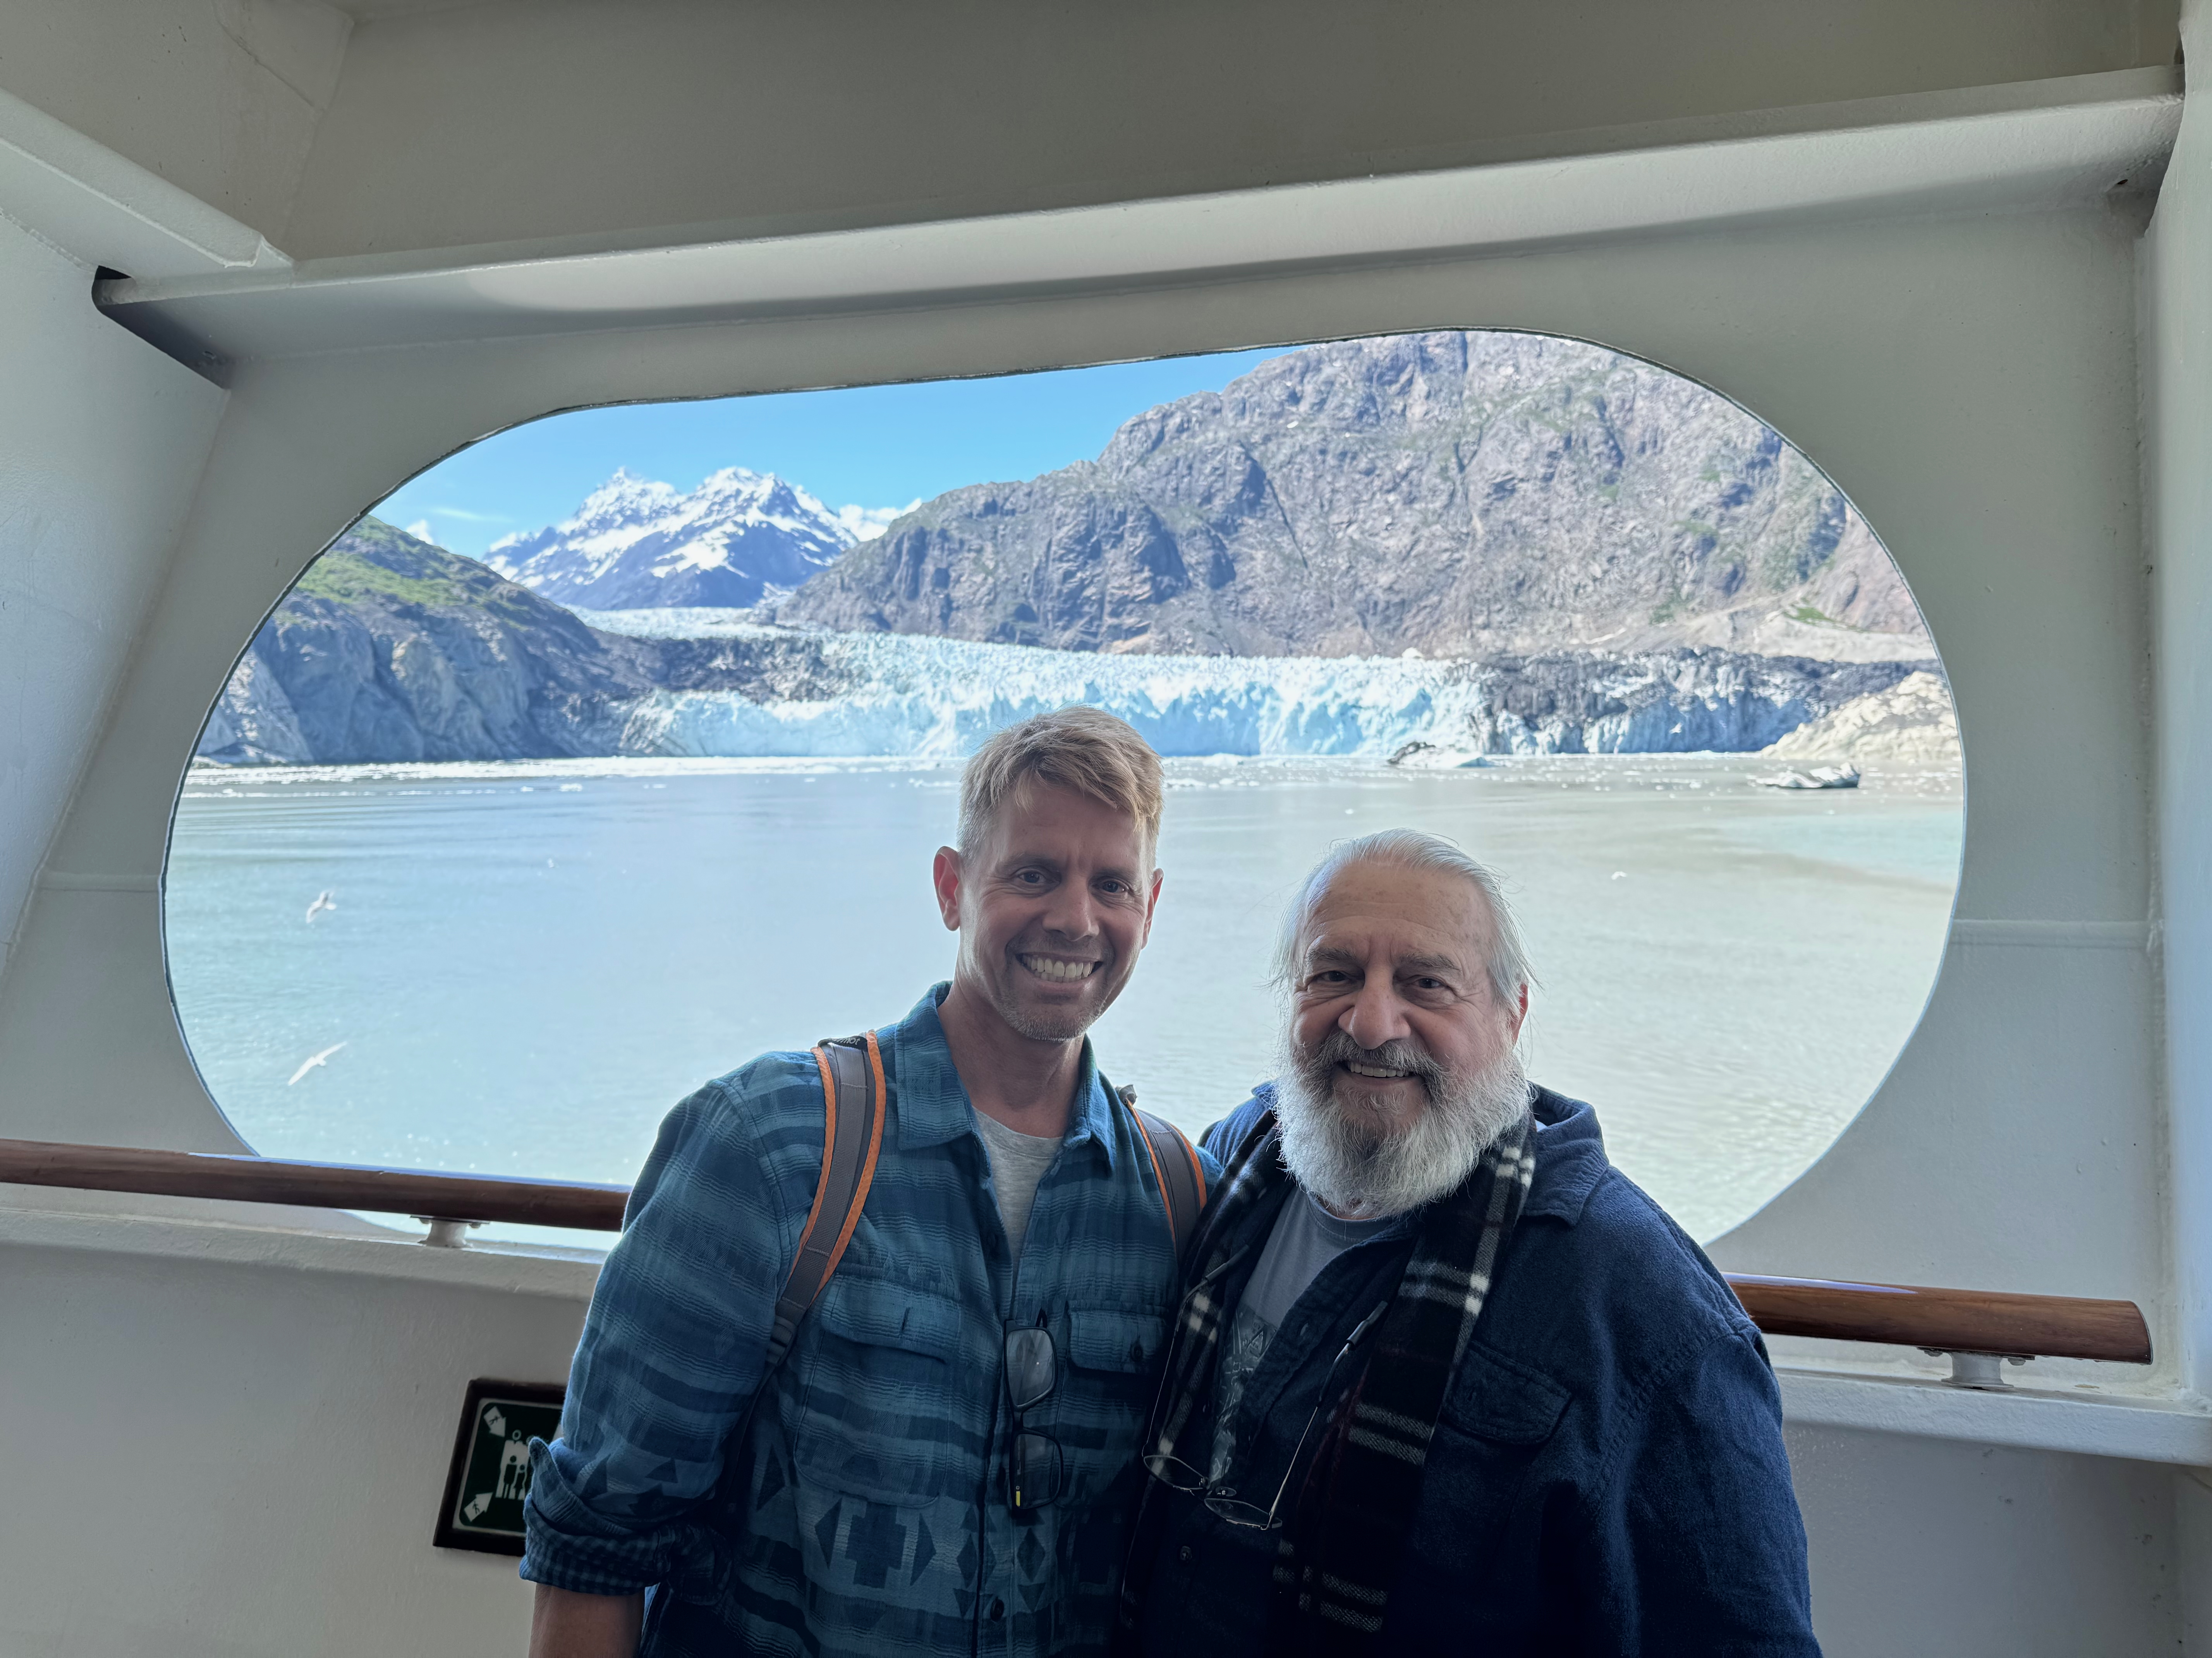
Greg Focaccio – Personal Info, Family
With Father
Alaska Cruise
July 2025
14

Slide 15
Greg Focaccio - Personal Info, Family
With Family
Denali, Alaska
July 2025
15

Slide 16
Greg Focaccio – Personal Info, Other
Hobbies / Interests
Technology - Building and learning new network and system designs in garage lab
Gardening, including Native Plants
Camping, Hiking, Bodysurfing, Tennis
Nature - Desert / Mountains / Beach
Fun Facts
Born the same day (within the hour) as the successful Apollo 11 Moon launch
Drunk from the Nile in Egypt (means I’ll go back someday)
Been inside King’s Chamber in the Great Pyramid (1991)
Completed 2 Rock N’ Roll Marathons (2007, 2010) (1/2 jog, 1/2 walk)
Summited San Jacinto (10,834 ft near Palm Springs)
Working towards Mt. Whitney (next year or two)
First computer was an IBM PC with two floppy drives, ascii graphics, and BASIC (still have)
Programmed Basic, Fortran, Pascal
Caravanned (with Dad) and Family (2008) down Baja California to Cabo San Lucas
16

Slide 17
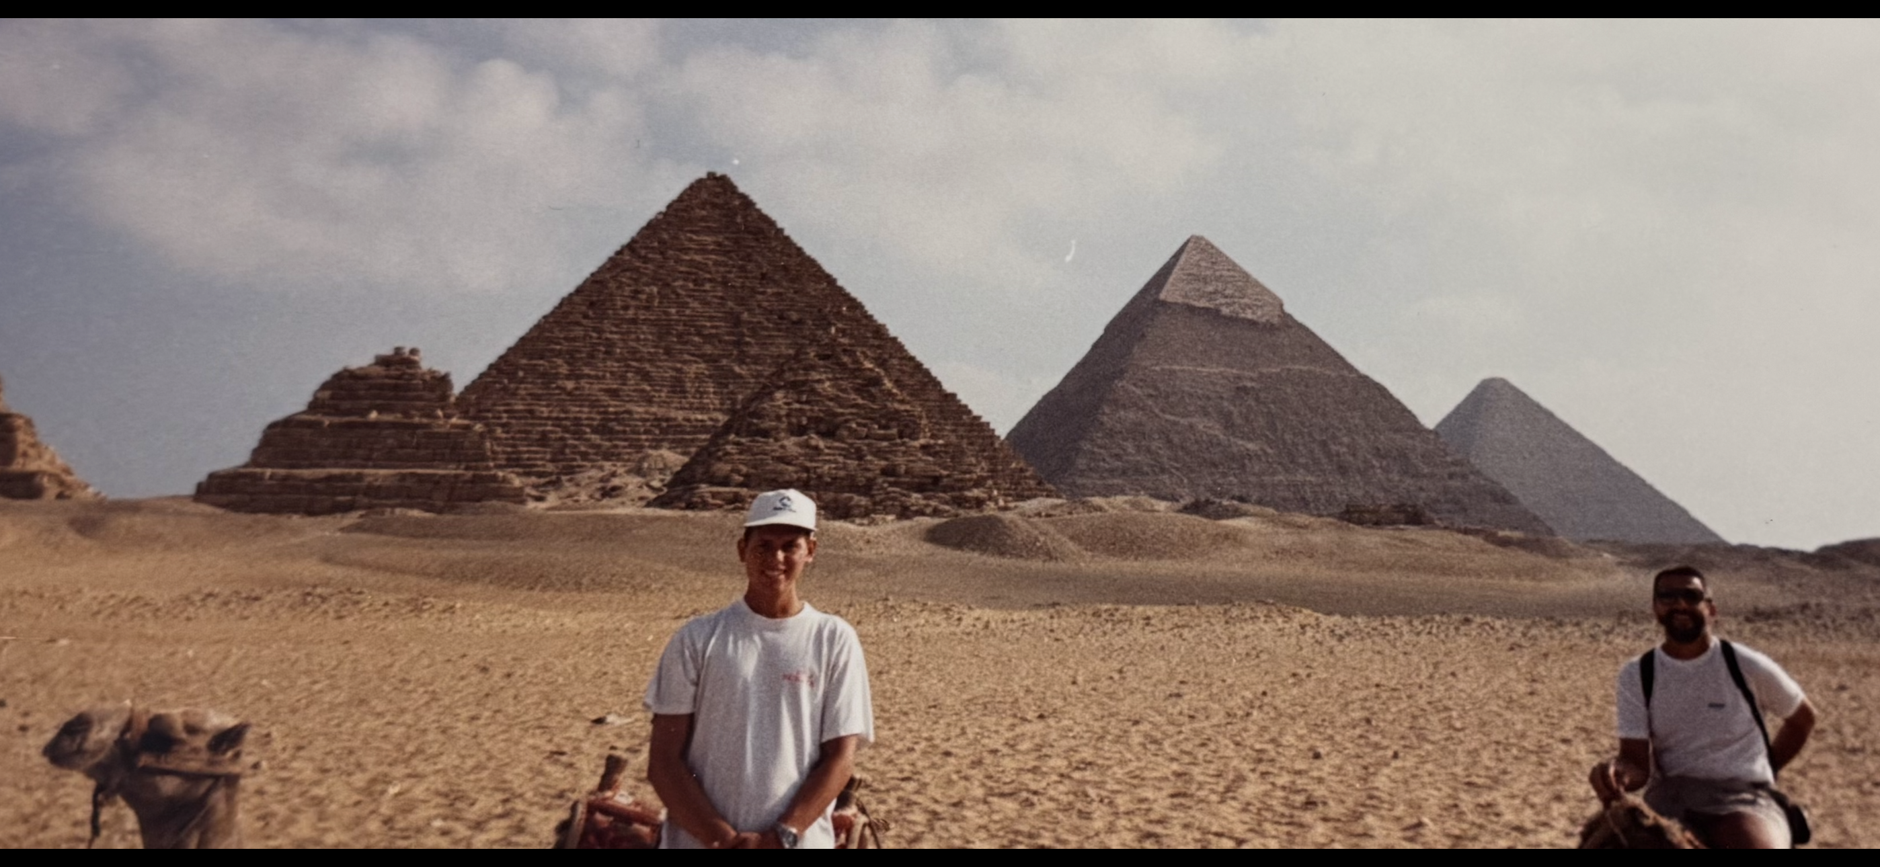

Greg Focaccio - Personal Info, Other
Egypt with Father
1991
Marathons
2007 & 2010
17

Slide 18
Greg Focaccio – Value from Differences
What Differentiates me that is of value to NIWC PAC
Perspective and Gratitude
Appreciation for the History, Prestige and Mission criticality of the Center
Grateful to be able to contribute to a Mission as an inherent motivation, versus commercial
Career Arc Position and Continuity
Latter in my Career Arc, hope and expect to remain with NIWC and NAVWAR
Continuity provides value, in maintaining state and supporting informed decision making
Qualities
Accept and Enjoy Difficult Challenges – Especially Network Centric
Enjoy working on the edge – Pushing technologies and breaking new ground
Natural Sincerity and Team Orientation
Background rooted in Science - Strong orientation for detail and testing
Imagination - Enjoy conceptualizing new ways of doing things
18

Slide 19
Greg Focaccio, Future
Family Life
Work Life, Now
Work Life, Future…
New ways to
contribute to
NIWC PAC
19

Slide 20
Greg Focaccio - NIWC PAC – Personal Goals
Short and Middle Term
Continue on Project as key Network technical performer
Mentor and train new network team member
Branch out to support other High Profile Projects
Learn more about Managerial Skills
Learn about RF, develop IP over RF network designs
Learn about Non-terrestrial network
Bring capabilities to from systems
Longer Term
Learn and begin training in Technical Team Management
Learn more about Acquisition Processes
Support NIWC PAC and NAVWAR Missions as technical team manager
Develop and participate in novel capability creation
Explore organizational design (Pure network RD w/in ST?)
18

